Slide 1

Role-Based Task Management System: Sprint 1 Analysis and Design
This document outlines the analysis and design components for Sprint 1 of the Role-Based Task Management System. It covers authentication setup using Keycloak, project and task creation, and RBAC implementation. Key diagrams and descriptions provide a solid technical foundation.

Slide 2
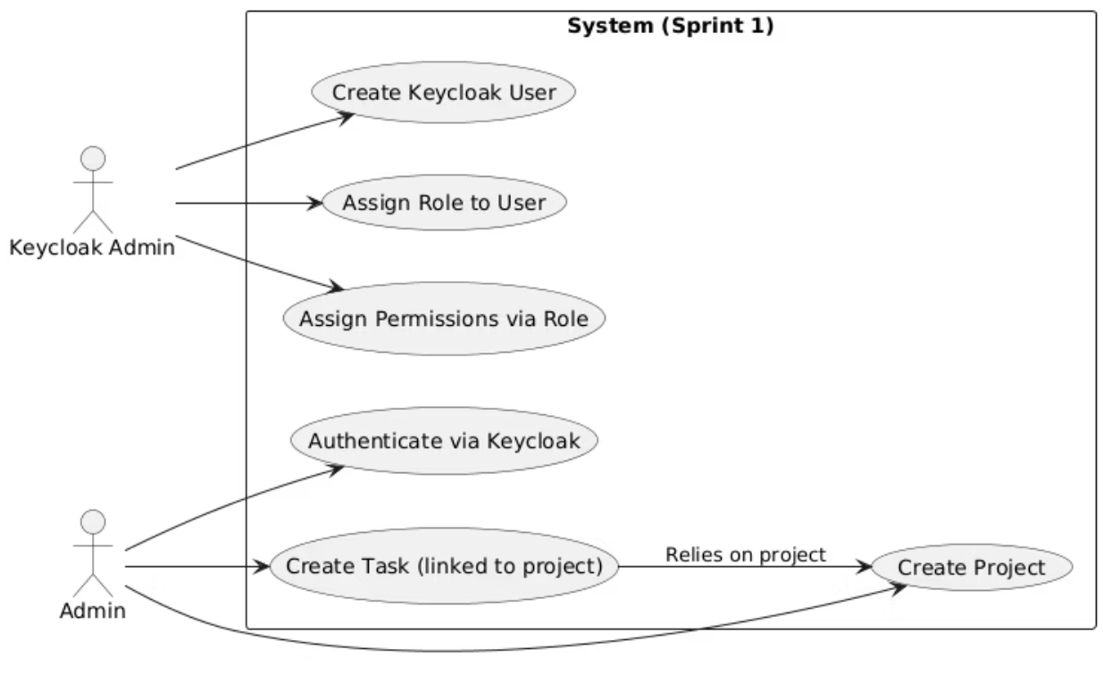
Use Case Diagram
This diagram shows the interactions between actors (Admin, Keycloak Admin) and the system during Sprint 1.

Slide 3
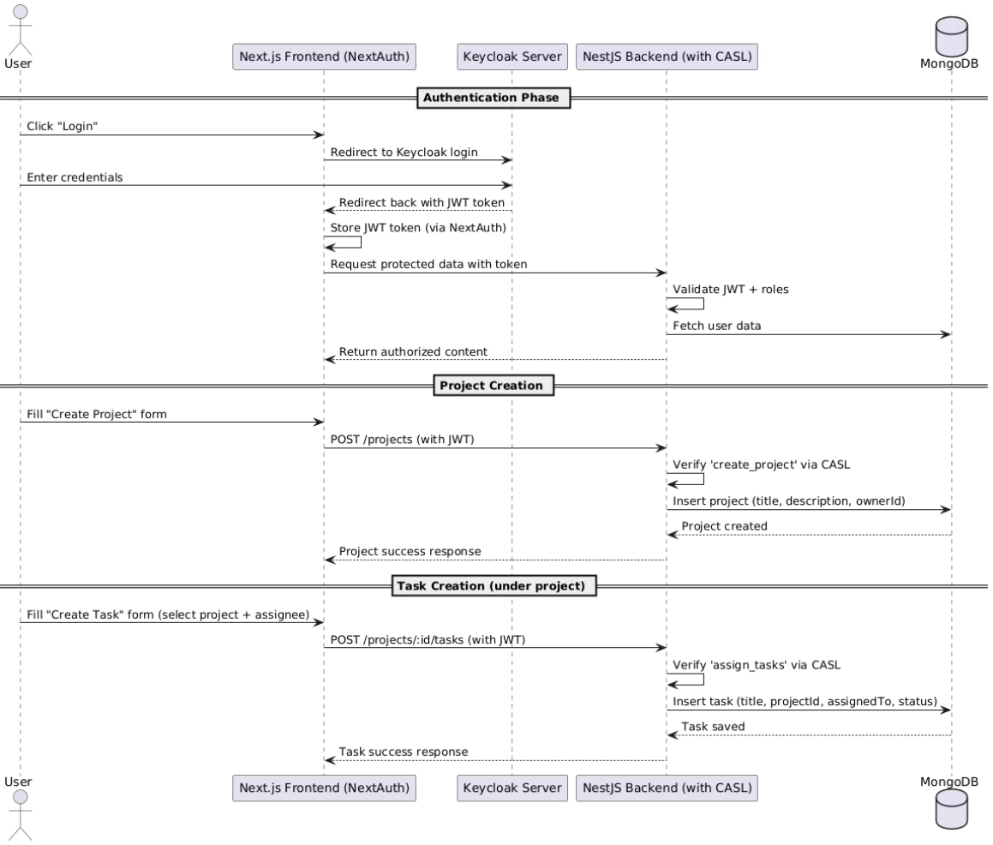
Sequence Diagram: Auth + Project & Task Creation
This diagram illustrates the flow of user authentication via Keycloak, creating a project, and creating a task under the project.

Slide 4
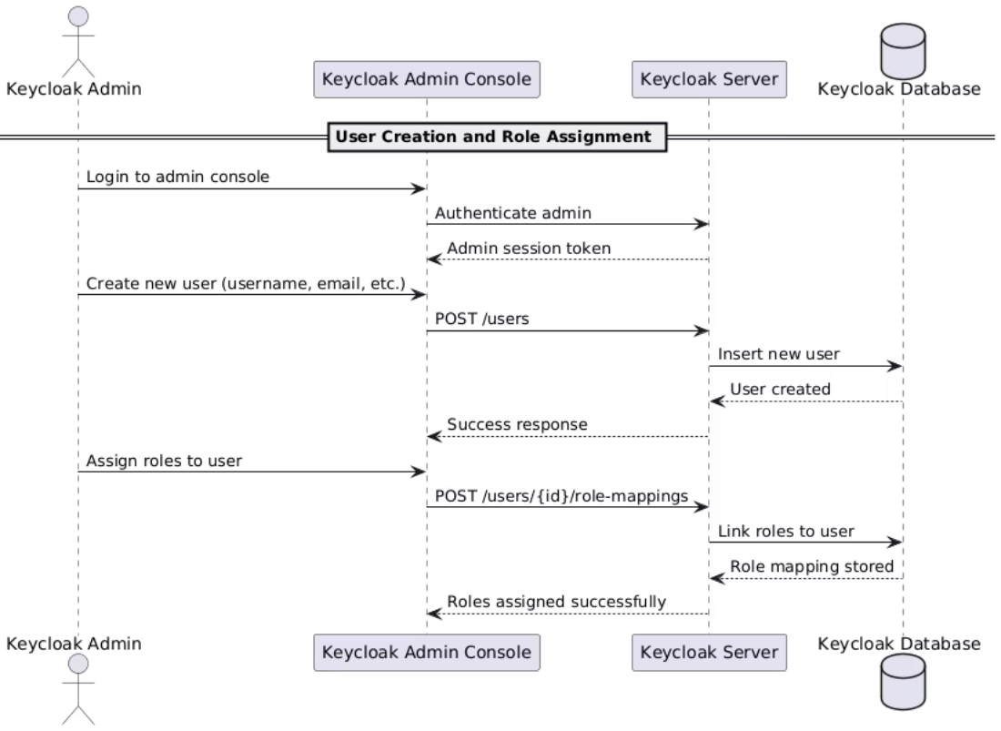
Sequence Diagram: Keycloak Admin Flow
This diagram illustrates how the Keycloak admin creates users and assigns them roles.

Slide 5
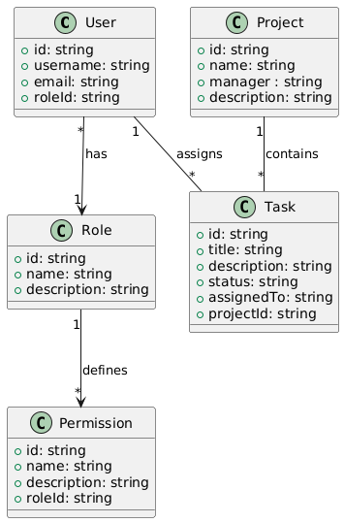
Class Diagram: Domain Entities
This diagram outlines the core domain entities and their relationships within the system in the sprint 1

Slide 6

Sprint 1 Summary
Key diagrams defining user interactions, clarifying authentication, and detailing entity implementation.
1
Use Case
Defines user interactions scoped to Sprint 1.
2
Sequence
Clarifies authentication, user management, and creation flows.
3
Class
Lays out entities to implement in the backend.

Slide 7

Next Steps
The diagrams provide a guide for developers during implementation and serve as references for Sprint 1 validation and testing.
1
Implementation
2
Validation
Developers to implement based on diagrams.
Validate implementation against diagrams.
3
Testing
Comprehensive testing of all flows.

